Slide 1
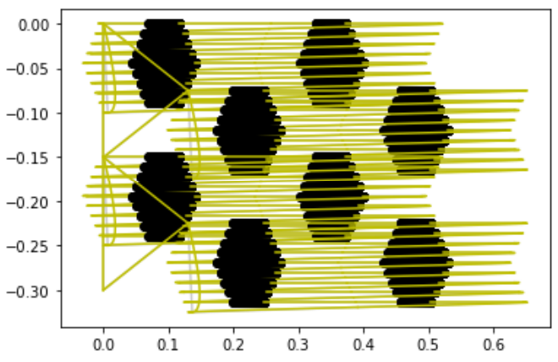
Unit Cell 1
Unit Cell 2
Unit Cell 3

